Slide 1


Zachary Long
07/06/2024

Slide 2

Outline
Executive Summary
Introduction
Methodology
Results
Conclusion
Appendix

Slide 3
Executive Summary
Summary of methodologies
Data Collection through API / Web Scraping
Exploratory Data Analysis with SQL
Exploratory Data Analysis with Data Visualization
Interactive Visual Analytics with Folium
Machine Learning Prediction
Summary of all results
Optimal model acquired
Good visualizations to help with decision making

Slide 4
Introduction
Project background and context
In this project the SpaceX company will need a prediction on the success of the Falon 9’s first stage. As the first stage of the Falcon 9 can be reused this will help drive down the cost of future missions
Problems you want to find answers
What factors determine if the rocket will land successfully?
What features determine the success rate?
What is the accuracy of a successful landing prediction?

Slide 5

Section 1

Slide 6
Methodology
Executive Summary
Data collection methodology
REST API and Web Scraping
Data Wrangling
Data was transformed and one-hot encoded to be applied to Machine Learning models
Using Exploratory Data Analysis(EDA) using visualization and SQL
EDA using Matplotlib, Seaborn and SQL
Perform interactive visual analytics
Using Folium and Plotly Dash
Predictive analysis using classification models
Create a machine learning pipeline to predict if the first stage will land given the previous data from past observations

Slide 7
Data Collection
The data was collected using various methods
Data collection was done using get-request to the SpaceX API.
decode the response content as a .json using .json() function call and turn it into a pandas dataframe.
Performed web scraping from Wikipedia for Falcon 9 launch records with BeautifulSoup.
Removed all Falcon 1 launches from the dataframe to focus on only Falcon 9.

Slide 8
Data Collection – SpaceX API
https://github.com/Zelzilon/DataScienceCapstone/blob/main/jupyter-labs-spacex-data-collection-api.ipynb
Request rocket launch data from SpaceX API using url
Decode the response content as a .json using and convert it into a panda dataframe
Fixed information in correct columns
Construct dataset using the data we have obtained

Slide 9
Data Collection - Scraping
https://github.com/Zelzilon/DataScienceCapstone/blob/main/jupyter-labs-webscraping.ipynb
Request the Falcon9 Launch wiki page from the url
Extract all column and variable names from the table header
Create a dataframe by parsing the launch tables

Slide 10
Data Wrangling
https://github.com/Zelzilon/DataScienceCapstone/blob/main/labs-jupyter-spacex-Data%20wrangling.ipynb
Deal with missing values
Calculate the number of launches on each site
Calculate the number and occurrence of each orbit
Calculate the number and occurrence of mission outcome per orbit type
Create a landing outcome label from Outcome column

Slide 11
EDA with Data Visualization
Charts used in this project are
Scatter plot – for comparing two variables
Bar Chart – to compare orbit to success rate
Line chart – to show change in success rate over the years
https://github.com/Zelzilon/DataScienceCapstone/blob/main/edadataviz.ipynb

Slide 12
EDA with SQL
SQL queries performed:
Display the name of unique launch sites
Display records beginning with ‘CCA’
Display total payload mass carried by NASA (CRS)
Display average payload mass carried by F9 v1.1
List date when the first successful landing outcome in the ground pad was achieved
List total number of successful and failure mission outcomes
List names of booster versions which have carried max payload mass
List failed landing outcome with booster version and site names in 2015
https://github.com/Zelzilon/DataScienceCapstone/blob/main/jupyter-labs-eda-sql-coursera_sqllite.ipynb

Slide 13
Build an Interactive Map with Folium
Summary of map objects:
Markers: Show a geo location from latitude and longitude data
Cluster: Show a group of markers
Circles: Show a single location
Lines: Show distance between two locations
https://github.com/Zelzilon/DataScienceCapstone/blob/main/lab_jupyter_launch_site_location.ipynb

Slide 14
Build a Dashboard with Plotly Dash
Summary of plots:
Bar - Show categorical differences
Line – Show changes over time
Pie – Show percentage of events
https://github.com/Zelzilon/DataScienceCapstone/blob/main/spacex_dash_app.py

Slide 15
Predictive Analysis (Classification)
https://github.com/Zelzilon/DataScienceCapstone/blob/main/SpaceX_Machine%20Learning%20Prediction_Part_5.ipynb
Create and Standardize the variable X and Create variable Y
Split data into Train and Test data sets
Calculate K Nearest Neighbor, Logistic Regression, Support Vector Machine, and Decision Tree
Calculate the number and occurrence of mission outcome per orbit type
Compare score accuracy to choose the best model

Slide 16
Results
Exploratory data analysis results
API and web scraping are capable to collect SpaceX data
Interactive analytics demo in screenshots
EDA with SQL is effective for data filtering
EDA with interactive visualization provides great information
Predictive analysis results
Decision Tree Classifier has the best accuracy

Slide 17

Section 2

Slide 18
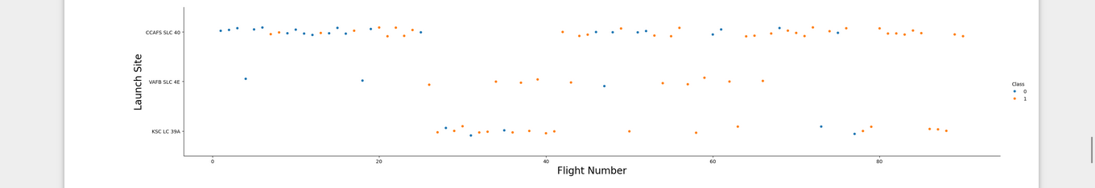
Flight Number vs. Launch Site
The CCFS SLC 40 site shows a higher concentration of flights

Slide 19
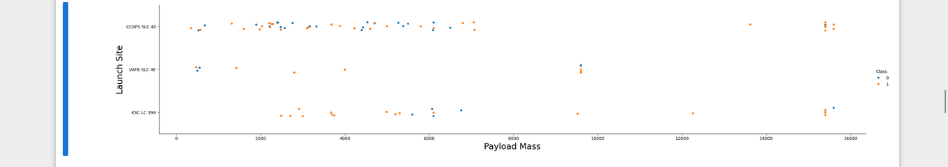
Payload vs. Launch Site
In this scatter plot you can observe that VAFB-SLC has no rockets of a payload mass greater than 10,000

Slide 20
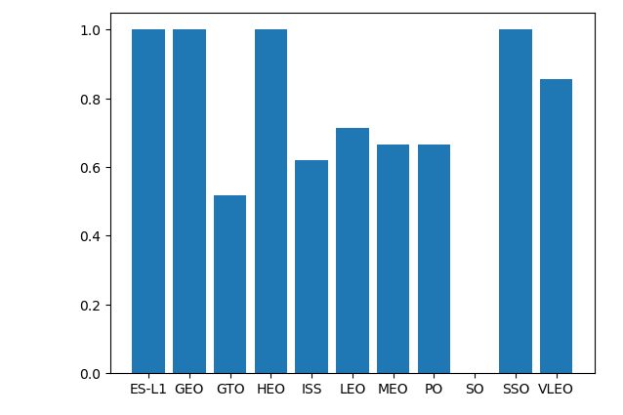
Success Rate vs. Orbit Type
From this chart we can see the highest success rates are from the orbits ES-L1, GEO,
HEO, and SSO.

Slide 21
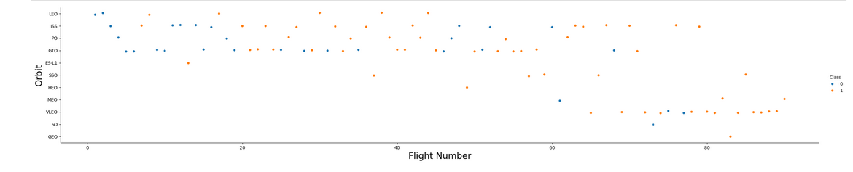
Flight Number vs. Orbit Type
You should see that in the LEO orbit the Success appears related to the number of flights; on the other hand, there seems to be no relationship between flight number when in GTO orbit.

Slide 22
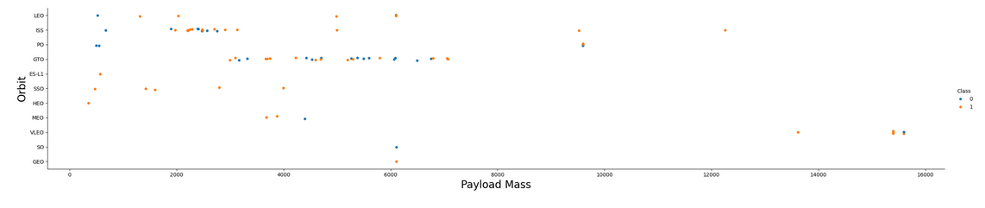
Payload vs. Orbit Type
With heavy payloads the successful landing or positive landing rate are more for Polar,LEO and ISS.
However for GTO we cannot distinguish this well as both positive landing rate and negative landing(unsuccessful mission) are both there here.

Slide 23
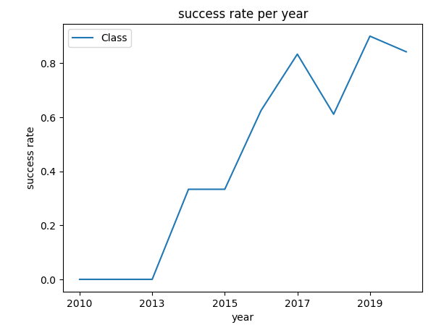
Launch Success Yearly Trend
You can observe that the success rate since 2013 kept increasing till 2020

Slide 24
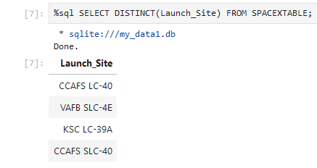
All Launch Site Names
The above picture is the SQL query and list of all four launch sites in the table.

Slide 25
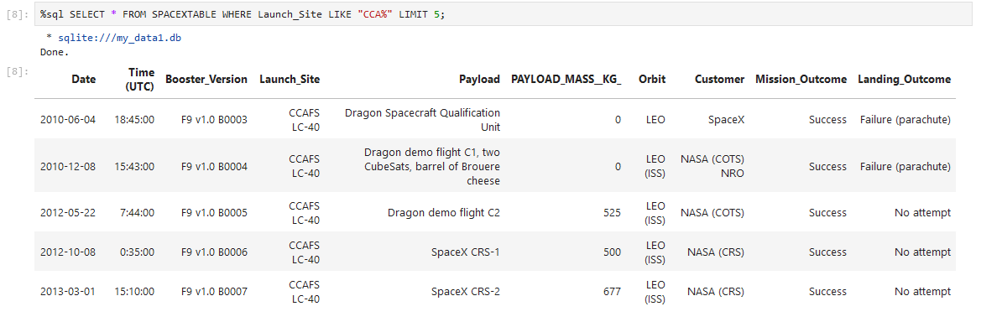
Launch Site Names Begin with 'CCA'
The above picture shows all information in 5 records with a Launch Site starting with ‘CCA’

Slide 26
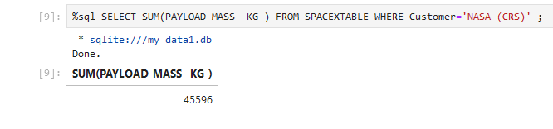
Total Payload Mass
Above is the SQL query to show the sum total of the payload mass carried by all boosters.

Slide 27
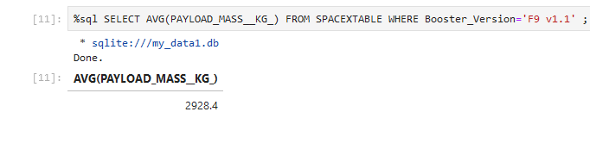
Average Payload Mass by F9 v1.1
Above is the average payload mass to be carried by the F9 v1.1

Slide 28
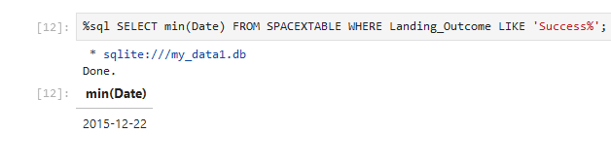
First Successful Ground Landing Date
Above is the earliest date of a successful landing outcome

Slide 29
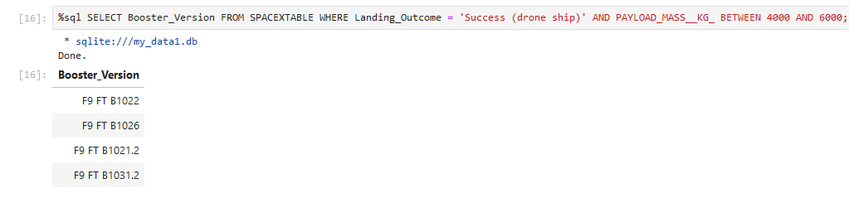
Successful Drone Ship Landing with Payload between 4000 and 6000
Above is the Boosters that have had a successful landing between 4,000 and 6,000kg

Slide 30
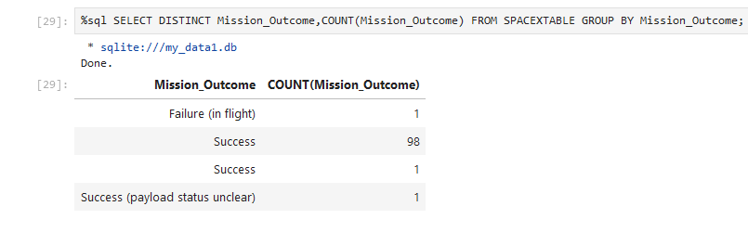
Total Number of Successful and Failure Mission Outcomes
Above shows the success and failures of the mission outcome, You can see that there is
only 1 recorded failure in the database.

Slide 31
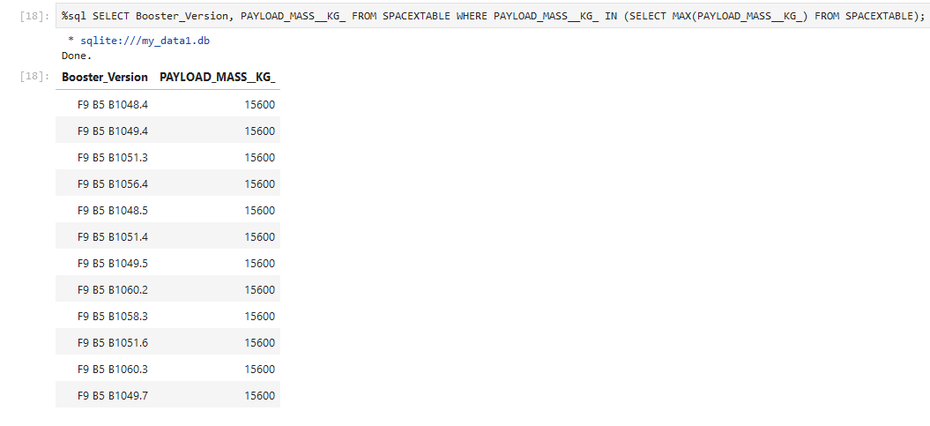
Boosters Carried Maximum Payload
Above is a list of the boosters that have carried the highest payload mass

Slide 32
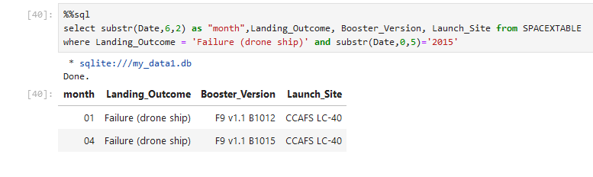
2015 Launch Records
Above shows 2 failed landing outcomes that occurred in 2015.

Slide 33
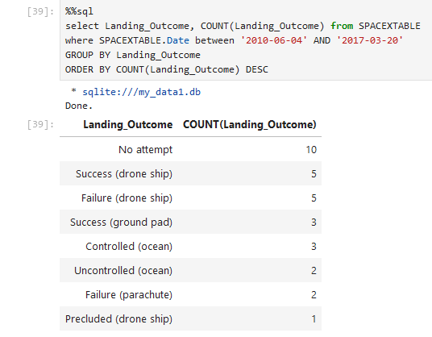
Rank Landing Outcomes Between 2010-06-04 and 2017-03-20
Above shows a descending list of the landing outcomes from the range of 2010-06-04 to 2017-03-20

Slide 34

Section 3

Slide 35
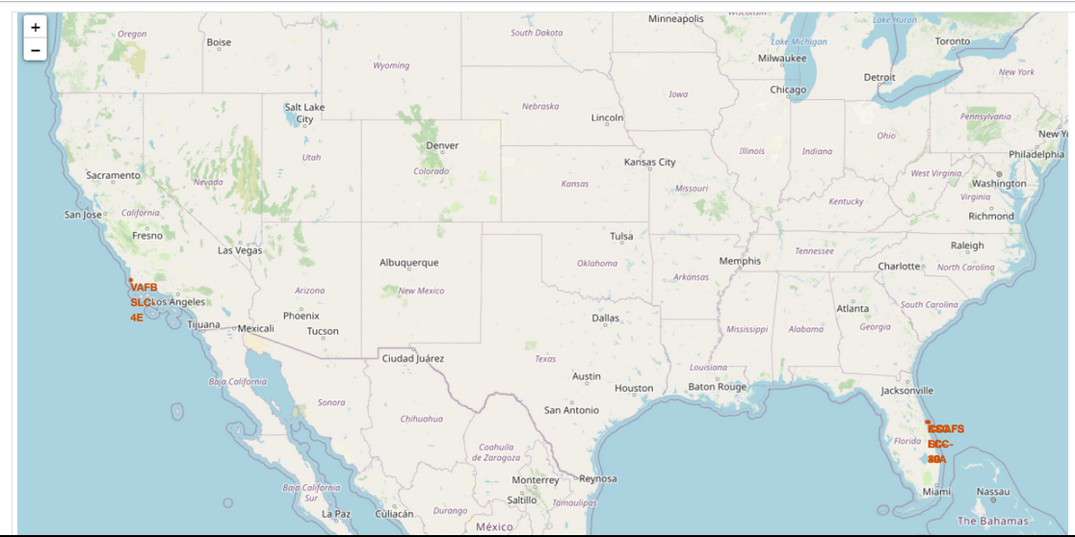
SpaceX Launch Sites
Above are the SpaceX Launch Sites, You can see that the sites are near the coast in Florida and California.

Slide 36
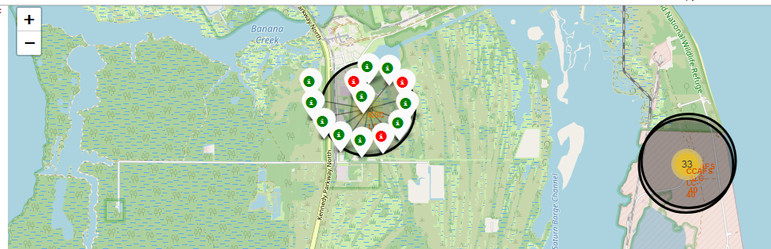
Launch Success Rate
Above is an example of the Folium map showing success and failures of the given location.

Slide 37
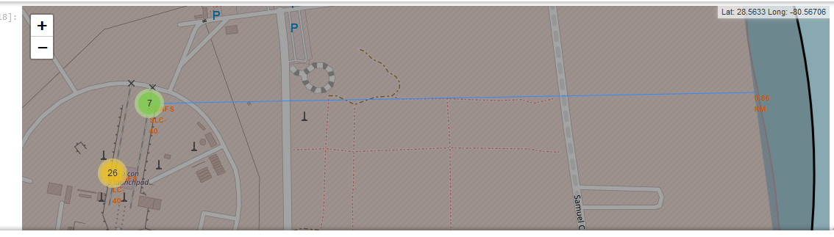
Distance from coastline
Above image shows a line with distance marked from the launch site to a nearest coastline.

Slide 38

Section 4

Slide 39
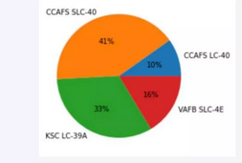
Launch site success
The above pie chart shows CCAFS SLC-40 is the most successful launch site at 41% of the successful launches.

Slide 40
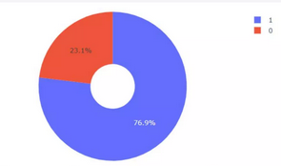
Success Rate by Site
KSC LC-39A shows a success rate of 76.9%

Slide 41
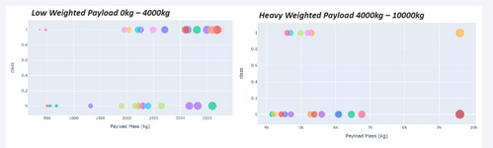
Payload and Successful Launches
We can see from the charts that the payloads of 0 – 4,000 have higher success rates

Slide 42

Section 5

Slide 43
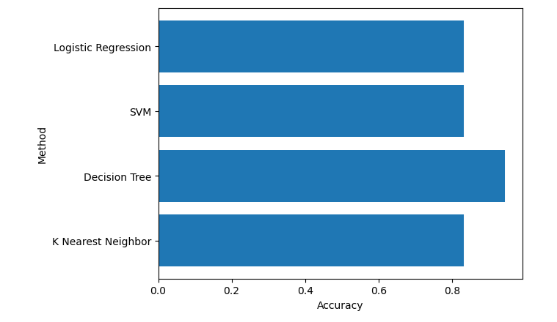
Classification Accuracy
The above bar chart shows the Decision Tree having the highest accuracy

Slide 44
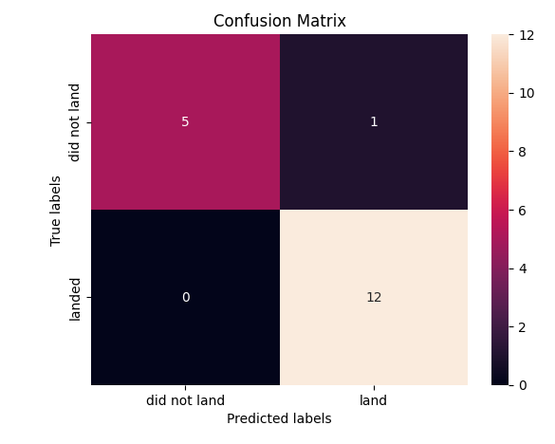
Confusion Matrix
The confusion matrix
for the decision tree model

Slide 45
Conclusions
Lower payloads have a higher success rate
GEO, HEO, SSO, ES L1 Orbits have the best success rate
CCAFS SLC-40 has the most successful launches
KSC LC 39A has a 76.9% success rate

Slide 46
Appendix
Include any relevant assets like Python code snippets, SQL queries, charts, Notebook outputs, or data sets that you may have created during this project

Slide 47


